Slide 1
Computing Technology
Notes:
Reload codespace
Uncheck VS Code tabs
https://www.youtube.com/watch?v=H0NflGpWgKA
https://www.youtube.com/watch?v=17MctJPzR8w

Slide 2
This is CS50
If you didn't get a rubber duck 🦆 yet, ask Yuliia during break or after class!
If you'd like to attend CS50 Lunch this Fri 10/4 at 1:15pm, RSVP at cs50.ly/lunch!
We'll be joined by alumni from Meta.
Today's snack, mini blueberry muffins! 🫐
Do say hi or ask questions during break or after class!
What do today's binary bulbs spell?

Slide 3
Computing Technology

Slide 4


Slide 7
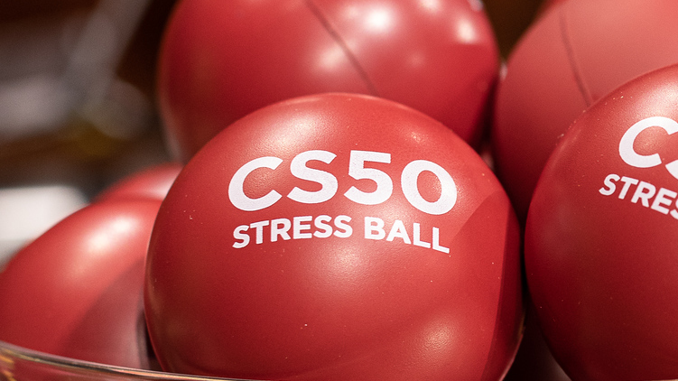

Slide 8
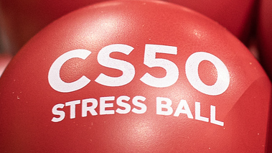

Slide 9


Slide 10


Slide 11


Slide 12
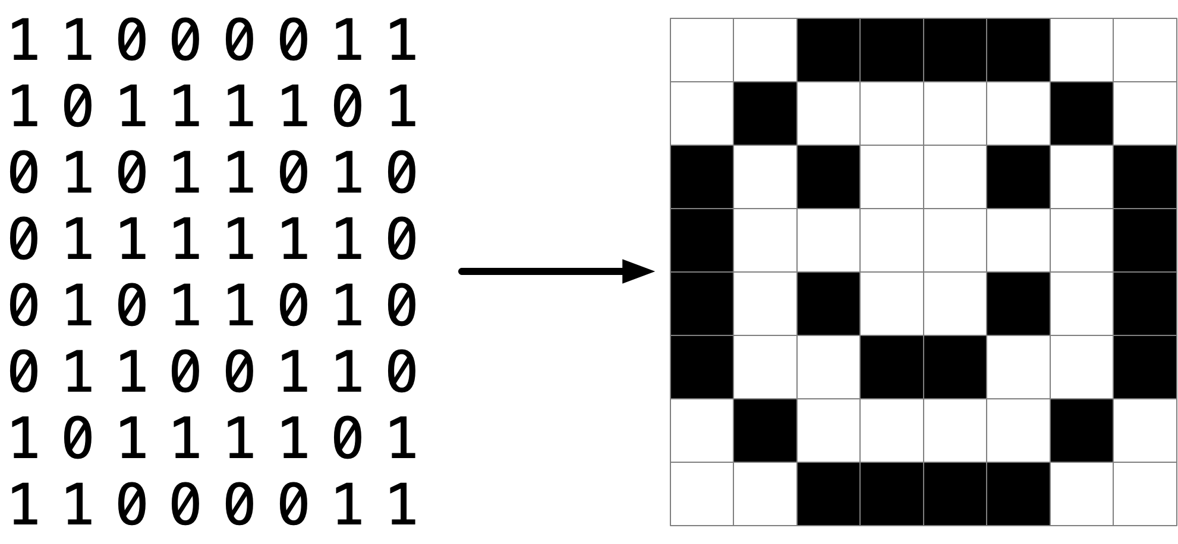

Slide 15
pixel art
Notes:
Reveal volunteer's artwork on stage, if any; invite others to make their own and send it to us

Slide 16
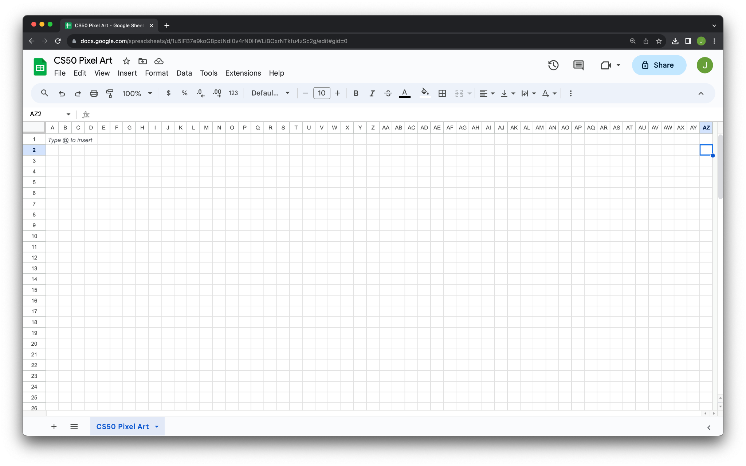

Slide 17


Slide 18
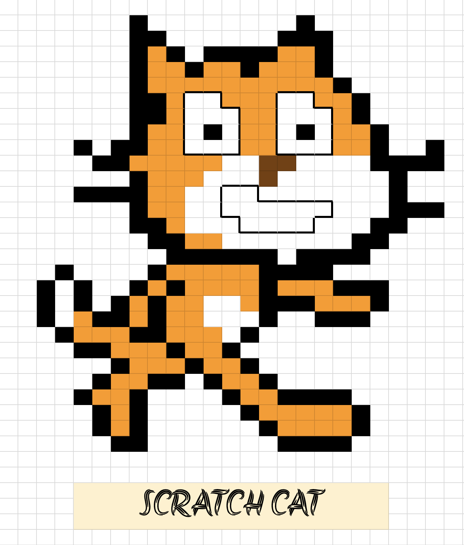

Slide 19
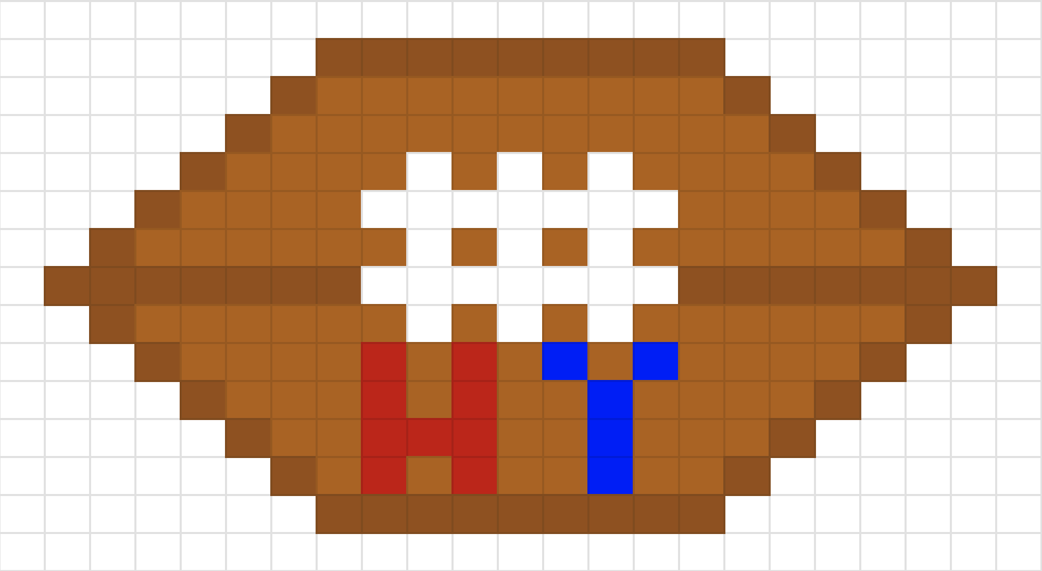

Slide 20


Slide 21
cs50.ly/art

Slide 22
RGB

Slide 23
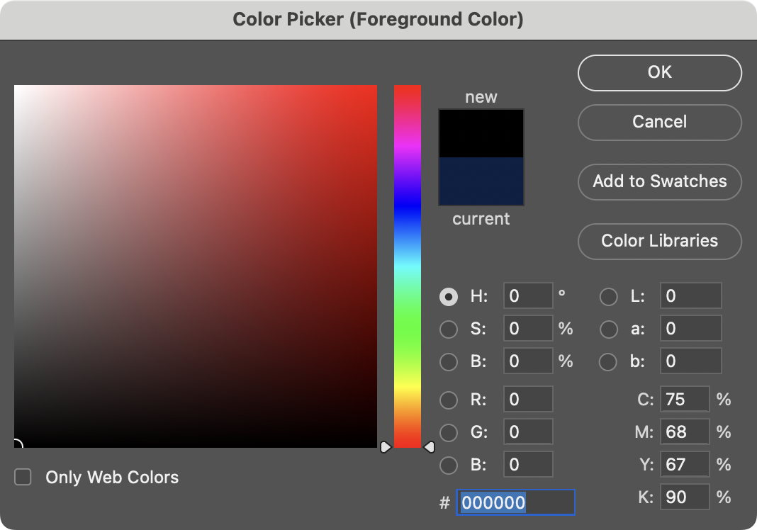

Slide 24
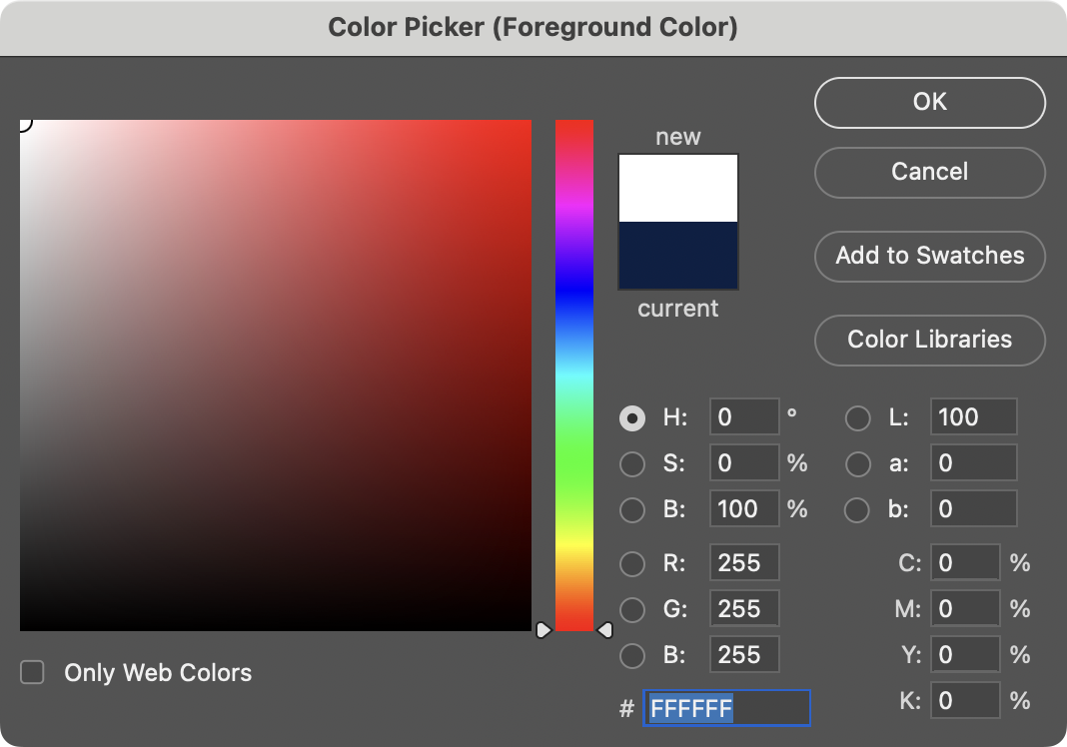
Notes:
White is 255 255 255. But what are these F's? hmmm

Slide 25
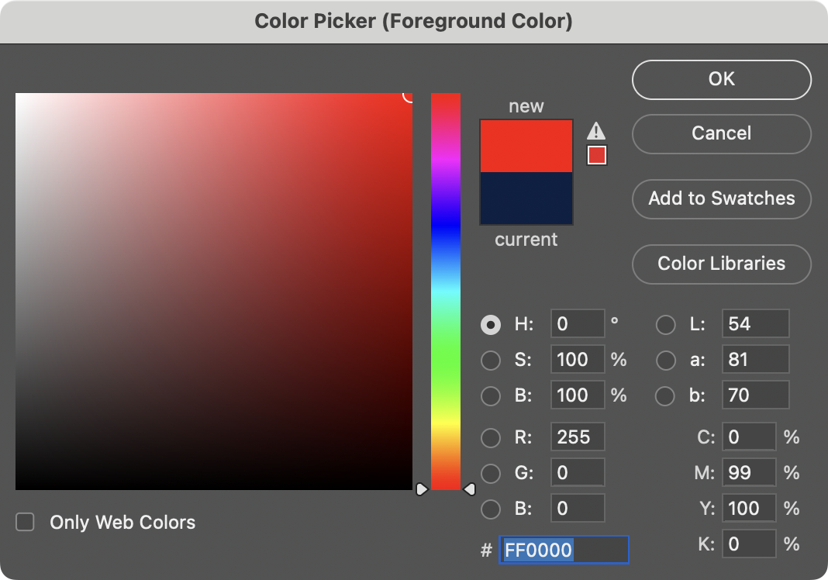

Slide 26
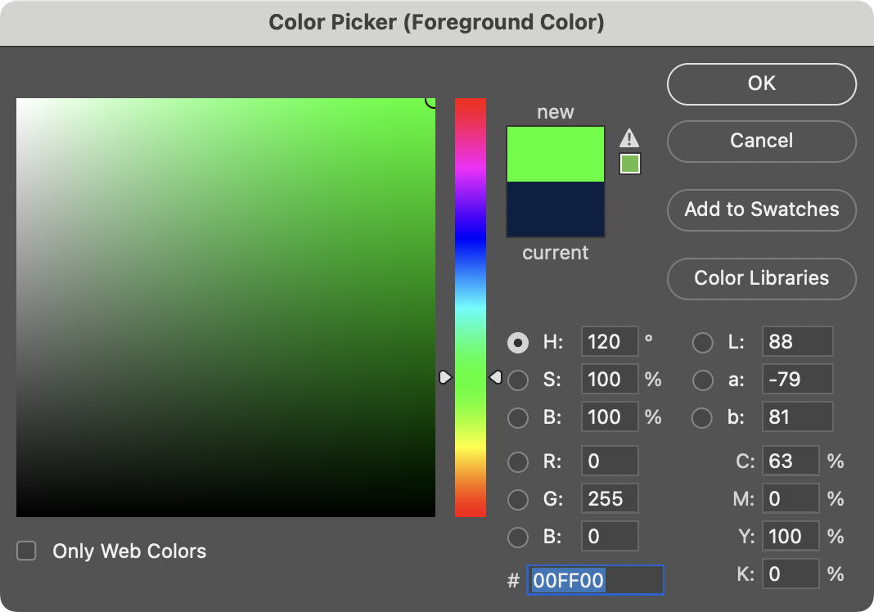

Slide 27
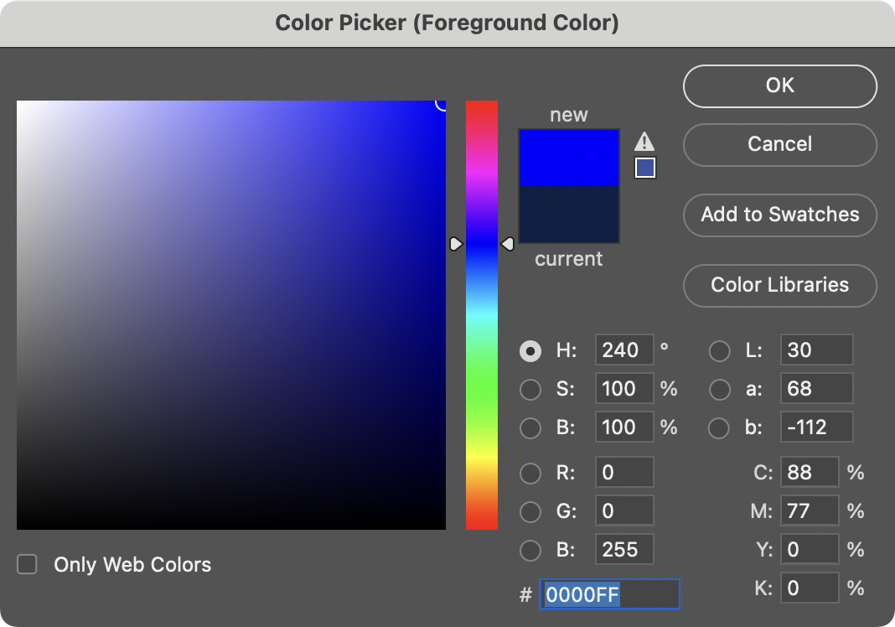

Slide 28
0 1 2 3 4 5 6 7 8 9 A B C D E F

Slide 29
0 1 2 3 4 5 6 7 8 9 A B C D E F

Slide 30
0 1 2 3 4 5 6 7 8 9 A B C D E F

Slide 31
0 1 2 3 4 5 6 7 8 9 a b c d e f

Slide 32
hexadecimal

Slide 33
base-16

Slide 34
16¹
16⁰
# #

Slide 35
16
1
# #

Slide 36
16
1
00

Slide 37
16
1
01

Slide 38
16
1
02

Slide 39
16
1
03

Slide 40
16
1
04

Slide 41
16
1
05

Slide 42
16
1
06

Slide 43
16
1
07

Slide 44
16
1
08

Slide 45
16
1
09

Slide 46
16
1
0A
Notes:
"ten"

Slide 47
16
1
0B
Notes:
"eleven"

Slide 48
16
1
0C

Slide 49
16
1
0D

Slide 50
16
1
0E

Slide 51
16
1
0F

Slide 52
16
1
10
Notes:
"one zero" not "ten"

Slide 53
16
1
11
Notes:
"one one", not "eleven"

Slide 54
16
1
12

Slide 55
16
1
13

Slide 56
16
1
14

Slide 57
16
1
…

Slide 58
16
1
FF

Slide 59
16
1
FF
16 × F
+
1 × F

Slide 60
16
1
FF
16 × 15
+
1 × 15

Slide 61
16
1
FF
240
+
15

Slide 62
16
1
FF
255
Notes:
So why is hex popular?

Slide 63
FF
Notes:
So why is hex popular?

Slide 64
F F
Notes:
So why is hex popular?

Slide 65
1111 1111
Notes:
So why is hex popular?

Slide 67
0 | 1 | 2 | 3 | 4 | 5 | 6 | 7
8 | 9 | 10 | 11 | 12 | 13 | 14 | 15
16 | 17 | 18 | 19 | 20 | 21 | 22 | 23
24 | 25 | 26 | 27 | 28 | 29 | 30 | 31

Slide 68
0 | 1 | 2 | 3 | 4 | 5 | 6 | 7
8 | 9 | A | B | C | D | E | F
10 | 11 | 12 | 13 | 14 | 15 | 16 | 17
18 | 19 | 1A | 1B | 1C | 1D | 1E | 1F

Slide 69
0 | 1 | 2 | 3 | 4 | 5 | 6 | 7
8 | 9 | A | B | C | D | E | F
10 | 11 | 12 | 13 | 14 | 15 | 16 | 17
18 | 19 | 1A | 1B | 1C | 1D | 1E | 1F

Slide 70
0x0 | 0x1 | 0x2 | 0x3 | 0x4 | 0x5 | 0x6 | 0x7
0x8 | 0x9 | 0xA | 0xB | 0xC | 0xD | 0xE | 0xF
0x10 | 0x11 | 0x12 | 0x13 | 0x14 | 0x15 | 0x16 | 0x17
0x18 | 0x19 | 0x1A | 0x1B | 0x1C | 0x1D | 0x1E | 0x1F

Slide 71
int n = 50;
Notes:
addresses0.c
Consider this code, how's it stored in memory?

Slide 73
 |  |  |  | 50 n

Slide 74
 |  |  |  | 50 0x123

Slide 75
&
*
Notes:
It turns out C has two operators that let us see and access addresses like that

Slide 76
%p
Notes:
addresses1.c

Slide 77
pointers
Notes:
A pointer is essentially an address, or more precisely a variable that can store an address.

Slide 78
int n = 50;
int *p = &n;
Notes:
addresses{2,3}.c

Slide 79
int n = 50;
int *p = &n;

Slide 80
int n = 50;
int* p = &n;

Slide 81
int n = 50;
int * p = &n;

Slide 82
int n = 50;
int *p = &n;

Slide 84
 |  |  |  | 50 n

Slide 85
 |  |  |  | 50 0x123

Slide 86
0x123 p
 |  |  |  | 50 0x123

Slide 87
0x123 p
 |  |  |  | 50 0x123

Slide 88
p
 |  |  |  | 50 0x123
Notes:
MAILBOX DEMO

Slide 89
string

Slide 90
string s = "HI!";

Slide 91
 |  |  | H | I | ! | \0

Slide 92
 |  |  | H s[0] | I s[1] | ! s[2] | \0 s[3]

Slide 93
 |  |  | H 0x123 | I 0x124 | ! 0x125 | \0 0x126

Slide 94
s
 |  |  | H 0x123 | I 0x124 | ! 0x125 | \0 0x126
Notes:
addresses{4,5}.c

Slide 95
0x123 s
 |  |  | H 0x123 | I 0x124 | ! 0x125 | \0 0x126
Notes:
addresses{4,5}.c

Slide 96
s
 |  |  | H 0x123 | I 0x124 | ! 0x125 | \0 0x126 | 0x127
Notes:
But who cares about the specific addresses, think of this just as a pointer literally, an arrow.

Slide 97
string s = "HI!";
Notes:
addresses6.c

Slide 98
string s = "HI!";

Slide 99
char *s = "HI!";
Notes:
addresses7.c
DROP TRAINING WHEELS.
It's just an address.

Slide 100
typedef struct
{
string name;
string number;
} person;
Notes:
So what is "string"? It's a type we defined for you. In fact, recall how we made our own type last week for a person.

Slide 101
typedef struct
{
string name;
string number;
} person;

Slide 102
typedef struct
{
string name;
string number;
} person;

Slide 103
typedef struct
{
string name;
string number;
} person;

Slide 104
typedef
Notes:
For instance, you could alias "integer" to be the same as "int". But no need to do that.

Slide 105
typedef int

Slide 106
typedef int integer;

Slide 107
typedef

Slide 108
typedef char *

Slide 109
typedef char * string;

Slide 110
typedef uint8_t BYTE;

Slide 111
typedef uint8_t BYTE;

Slide 112
typedef uint8_t BYTE;

Slide 113
typedef char *string;

Slide 114
typedef char *string;

Slide 115
typedef char *string;

Slide 116
cs50.h

Slide 117
pointer arithmetic
Notes:
addresses{8,9,10}.c
Were these ints instead of chars, you would still do +1, and the compiler would know that it's really +4.

Slide 118
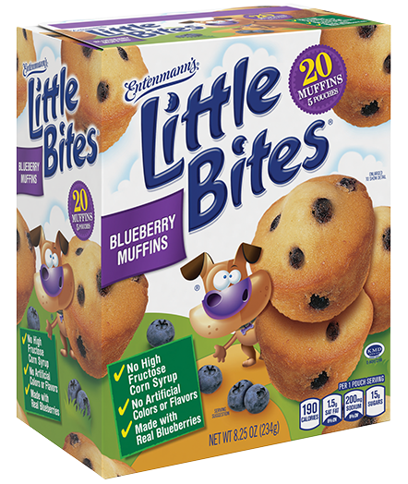
Notes:
https://www.littlebites.com/variety/little-bites-blueberry-muffins

Slide 119
typedef char * string;

Slide 120
typedef char *string;

Slide 121
Notes:
compare0.c

Slide 122
50 i |  |  |  | 50 j

Slide 123
strcmp
Notes:
compare{1,2}.c
Have to type "HI!"

Slide 125
s

Slide 126
s
 |  | H | I | ! | \0

Slide 127
s
 |  | H 0x123 | I 0x124 | ! 0x125 | \0 0x126

Slide 128
0x123 s
 |  | H 0x123 | I 0x124 | ! 0x125 | \0 0x126

Slide 129
0x123 s |  |  |  |  |  |  |  | t
 |  | H 0x123 | I 0x124 | ! 0x125 | \0 0x126

Slide 130
0x123 s |  |  |  |  |  |  |  | t
 |  | H 0x123 | I 0x124 | ! 0x125 | \0 0x126 |  |  |  |  | H | I | ! | \0

Slide 131
0x123 s |  |  |  |  |  |  |  | t
 |  | H 0x123 | I 0x124 | ! 0x125 | \0 0x126 |  |  |  |  | H 0x456 | I 0x457 | ! 0x458 | \0 0x459

Slide 132
0x123 s |  |  |  |  |  |  |  | 0x456 t
 |  | H 0x123 | I 0x124 | ! 0x125 | \0 0x126 |  |  |  |  | H 0x456 | I 0x457 | ! 0x458 | \0 0x459

Slide 133
s |  |  |  |  |  |  |  | t
 |  | H 0x123 | I 0x124 | ! 0x125 | \0 0x126 |  |  |  |  | H 0x456 | I 0x457 | ! 0x458 | \0 0x459
Notes:
compare{3,4}.c

Slide 134
Notes:
copy{0,1}.c
Have to use "hi!" in lowercase

Slide 135
s

Slide 136
s
 |  | h | i | ! | \0

Slide 137
s
 |  | h 0x123 | i 0x124 | ! 0x125 | \0 0x126

Slide 138
0x123 s
 |  | h 0x123 | i 0x124 | ! 0x125 | \0 0x126

Slide 139
0x123 s |  |  |  |  |  |  |  | t
 |  | h 0x123 | i 0x124 | ! 0x125 | \0 0x126

Slide 140
0x123 s |  |  |  |  |  |  |  | 0x123 t
 |  | h 0x123 | i 0x124 | ! 0x125 | \0 0x126

Slide 141
s |  |  |  |  |  |  |  | t
 |  | h 0x123 | i 0x124 | ! 0x125 | \0 0x126

Slide 142
s |  |  |  |  |  |  |  | t
 |  | H 0x123 | i 0x124 | ! 0x125 | \0 0x126

Slide 143
malloc
free
…
Notes:
copy{2,3,4}.c

Slide 144
s
 |  | h 0x123 | i 0x124 | ! 0x125 | \0 0x126

Slide 145
s |  |  |  |  |  |  |  | t
 |  | h 0x123 | i 0x124 | ! 0x125 | \0 0x126

Slide 146
s |  |  |  |  |  |  |  | t
 |  | h 0x123 | i 0x124 | ! 0x125 | \0 0x126 |  |  |  |  | 0x456 | 0x457 | 0x458 | 0x459

Slide 147
s |  |  |  |  |  |  |  | t
 |  | h 0x123 | i 0x124 | ! 0x125 | \0 0x126 |  |  |  |  | 0x456 | 0x457 | 0x458 | 0x459

Slide 148
s |  |  |  |  |  |  |  | t
 |  | h 0x123 | i 0x124 | ! 0x125 | \0 0x126 |  |  |  |  | h 0x456 | 0x457 | 0x458 | 0x459

Slide 149
s |  |  |  |  |  |  |  | t
 |  | h 0x123 | i 0x124 | ! 0x125 | \0 0x126 |  |  |  |  | h 0x456 | i 0x457 | 0x458 | 0x459

Slide 150
s |  |  |  |  |  |  |  | t
 |  | h 0x123 | i 0x124 | ! 0x125 | \0 0x126 |  |  |  |  | h 0x456 | i 0x457 | ! 0x458 | 0x459

Slide 151
s |  |  |  |  |  |  |  | t
 |  | h 0x123 | i 0x124 | ! 0x125 | \0 0x126 |  |  |  |  | h 0x456 | i 0x457 | ! 0x458 | \0 0x459

Slide 152
s |  |  |  |  |  |  |  | t
 |  | h 0x123 | i 0x124 | ! 0x125 | \0 0x126 |  |  |  |  | H 0x456 | i 0x457 | ! 0x458 | \0 0x459

Slide 153
NULL
Notes:
copy5.c

Slide 154
valgrind
Notes:
memory.c, create in advance
[Note: not necessary to free strings returned by get_string, CS50's library does for you.]

Slide 155
garbage values
Notes:
garbage.c

Slide 156
int main(void)
{
int *x;
int *y;
x = malloc(sizeof(int));
*x = 42;
*y = 13;
y = x;
*y = 13;
}

Slide 157
int main(void)
{
int *x;
int *y;
x = malloc(sizeof(int));
*x = 42;
*y = 13;
y = x;
*y = 13;
}

Slide 158
int main(void)
{
int *x;
int *y;
x = malloc(sizeof(int));
*x = 42;
*y = 13;
y = x;
*y = 13;
}

Slide 159
int main(void)
{
int *x;
int *y;
x = malloc(sizeof(int));
*x = 42;
*y = 13;
y = x;
*y = 13;
}

Slide 160
int main(void)
{
int *x;
int *y;
x = malloc(sizeof(int));
*x = 42;
*y = 13;
y = x;
*y = 13;
}

Slide 161
int main(void)
{
int *x;
int *y;
x = malloc(sizeof(int));
*x = 42;
*y = 13;
y = x;
*y = 13;
}
Notes:
So maybe we shouldn't do that

Slide 162
int main(void)
{
int *x;
int *y;
x = malloc(sizeof(int));
*x = 42;
*y = 13;
y = x;
*y = 13;
}
Notes:
But what if we instead…

Slide 163
int main(void)
{
int *x;
int *y;
x = malloc(sizeof(int));
*x = 42;
*y = 13;
y = x;
*y = 13;
}

Slide 164
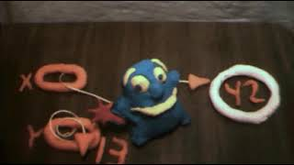
Notes:
https://www.youtube.com/watch?v=3uLKjb973HU

Slide 165
void swap(int a, int b)
{
}
Notes:
A lot of last week's demos involved swapping…
DRINKING GLASS DEMO

Slide 166
void swap(int a, int b)
{
int tmp = a;
a = b;
b = tmp;
}
Notes:
swap0.c
Have this one ready to go in a swap.c file

Slide 167
void swap(int a, int b)
{
int tmp = a;
a = b;
b = tmp;
}

Slide 168
scope

Slide 169
passing by value

Slide 170
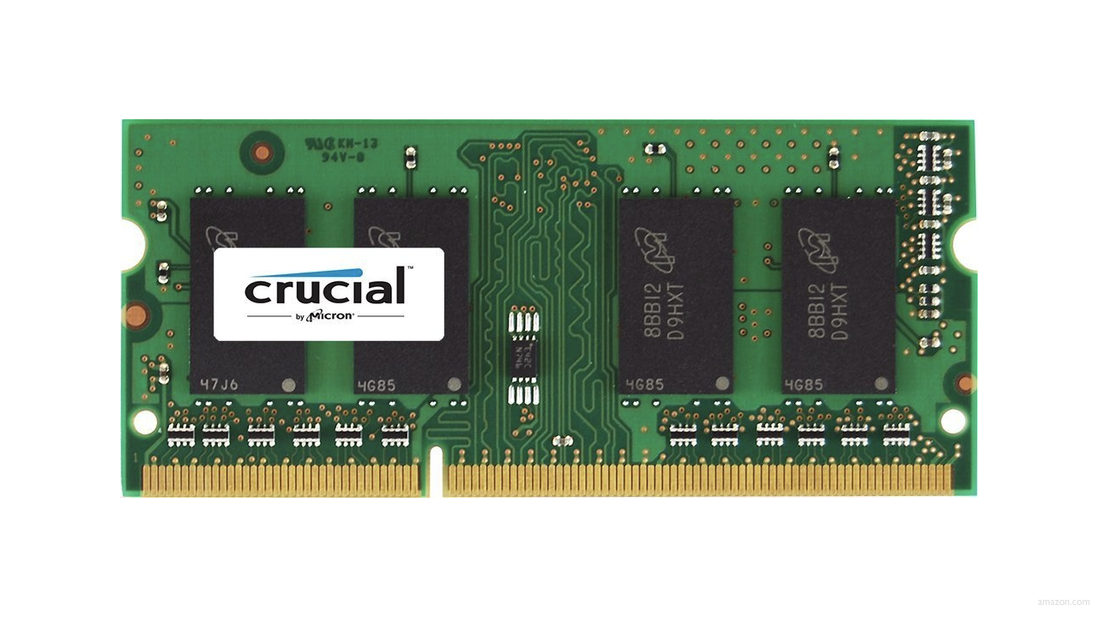

Slide 174
↑
stack

Slide 175
machine code
↑
stack

Slide 176
machine code
globals
heap
↓
↑
stack

Slide 177
machine code
globals
heap
↓
↑
stack

Slide 178
machine code
globals
heap
↓
↑
stack

Slide 179
machine code
globals
heap
↓
↑
stack

Slide 180
machine code
globals
heap
↓
↑
stack

Slide 181
↑
stack
Notes:
show swap0.c again

Slide 182
void swap(int a, int b)
{
int tmp = a;
a = b;
b = tmp;
}

Slide 183
main

Slide 184
swap
main

Slide 185
main

Slide 186
x
y

Slide 187
1
x
2
y

Slide 188
swap
1
x
2
y

Slide 189
a
b
tmp
1
x
2
y

Slide 190
1
a
2
b
tmp
1
x
2
y

Slide 191
int tmp = a;
a = b;
b = tmp;
1
a
2
b
tmp
1
x
2
y

Slide 192
int tmp = a;
a = b;
b = tmp;
1
a
2
b
1
tmp
1
x
2
y

Slide 193
int tmp = a;
a = b;
b = tmp;
2
a
2
b
1
tmp
1
x
2
y

Slide 194
int tmp = a;
a = b;
b = tmp;
2
a
1
b
1
tmp
1
x
2
y

Slide 195
2
a
1
b
1
tmp
1
x
2
y

Slide 196
1
x
2
y

Slide 197
passing by reference
Notes:
so how fix?

Slide 198
void swap(int a, int b)
{
int tmp = a;
a = b;
b = tmp;
}

Slide 199
void swap(int *a, int *b)
{
int tmp = *a;
*a = *b;
*b = tmp;
}

Slide 200
void swap(int *a, int *b)
{
int tmp = *a;
*a = *b;
*b = tmp;
}
Notes:
swap1.c

Slide 201
1
x
2
y

Slide 202
a
b
tmp
1
x
2
y

Slide 203
int tmp = *a;
*a = *b;
*b = tmp;
a
b
tmp
1
x
2
y

Slide 204
int tmp = *a;
*a = *b;
*b = tmp;
a
b
1
tmp
1
x
2
y

Slide 205
int tmp = *a;
*a = *b;
*b = tmp;
a
b
1
tmp
2
x
2
y

Slide 206
int tmp = *a;
*a = *b;
*b = tmp;
a
b
1
tmp
2
x
1
y

Slide 207
a
b
1
tmp
2
x
1
y

Slide 208
2
x
1
y

Slide 209
void swap(int a, int b)
{
int tmp = a;
a = b;
b = tmp;
}

Slide 210
void swap(int *a, int *b)
{
int tmp = *a;
*a = *b;
*b = tmp;
}

Slide 211
machine code
globals
heap
↓
↑
stack

Slide 212
heap
↓
↑
stack
Notes:
What's bad about this picture?

Slide 213
heap overflow
stack overflow

Slide 214
buffer overflow

Slide 215


Slide 216
"Sensors that received the new version of Channel File 291 carrying the problematic content were exposed to a latent out-of-bounds read issue in the Content Interpreter. At the next IPC notification from the operating system, the new IPC Template Instances were evaluated, specifying a comparison against the 21st input value. The Content Interpreter expected only 20 values. Therefore, the attempt to access the 21st value produced an out-of-bounds memory read beyond the end of the input data array and resulted in a system crash."
Notes:
https://www.crowdstrike.com/wp-content/uploads/2024/08/Channel-File-291-Incident-Root-Cause-Analysis-08.06.2024.pdf

Slide 217
"Sensors that received the new version of Channel File 291 carrying the problematic content were exposed to a latent out-of-bounds read issue in the Content Interpreter. At the next IPC notification from the operating system, the new IPC Template Instances were evaluated, specifying a comparison against the 21st input value. The Content Interpreter expected only 20 values. Therefore, the attempt to access the 21st value produced an out-of-bounds memory read beyond the end of the input data array and resulted in a system crash."

Slide 218
get_char
get_double
get_float
get_int
get_long
get_string
...
Notes:
So how about these other training wheels?

Slide 219
get_int
Notes:
get0.c

Slide 220
scanf
…
Notes:
get1.c

Slide 222


Slide 223
 | 50 n

Slide 225
Notes:
get2.c

Slide 226
s

Slide 227
s

Slide 228
s

Slide 230
Notes:
get3.c

Slide 231
s
Notes:
get3.c
get_int allocates just enough memory + 1

Slide 232
file I/O

Slide 233
fopen
fclose
fprintf
fscanf
fread
fwrite
fseek
…
Notes:
phonebook{0,1}.c

Slide 234

Notes:
cp.c
https://stock.adobe.com/search/video?k=progress+bar

Slide 235
BMP

Slide 236
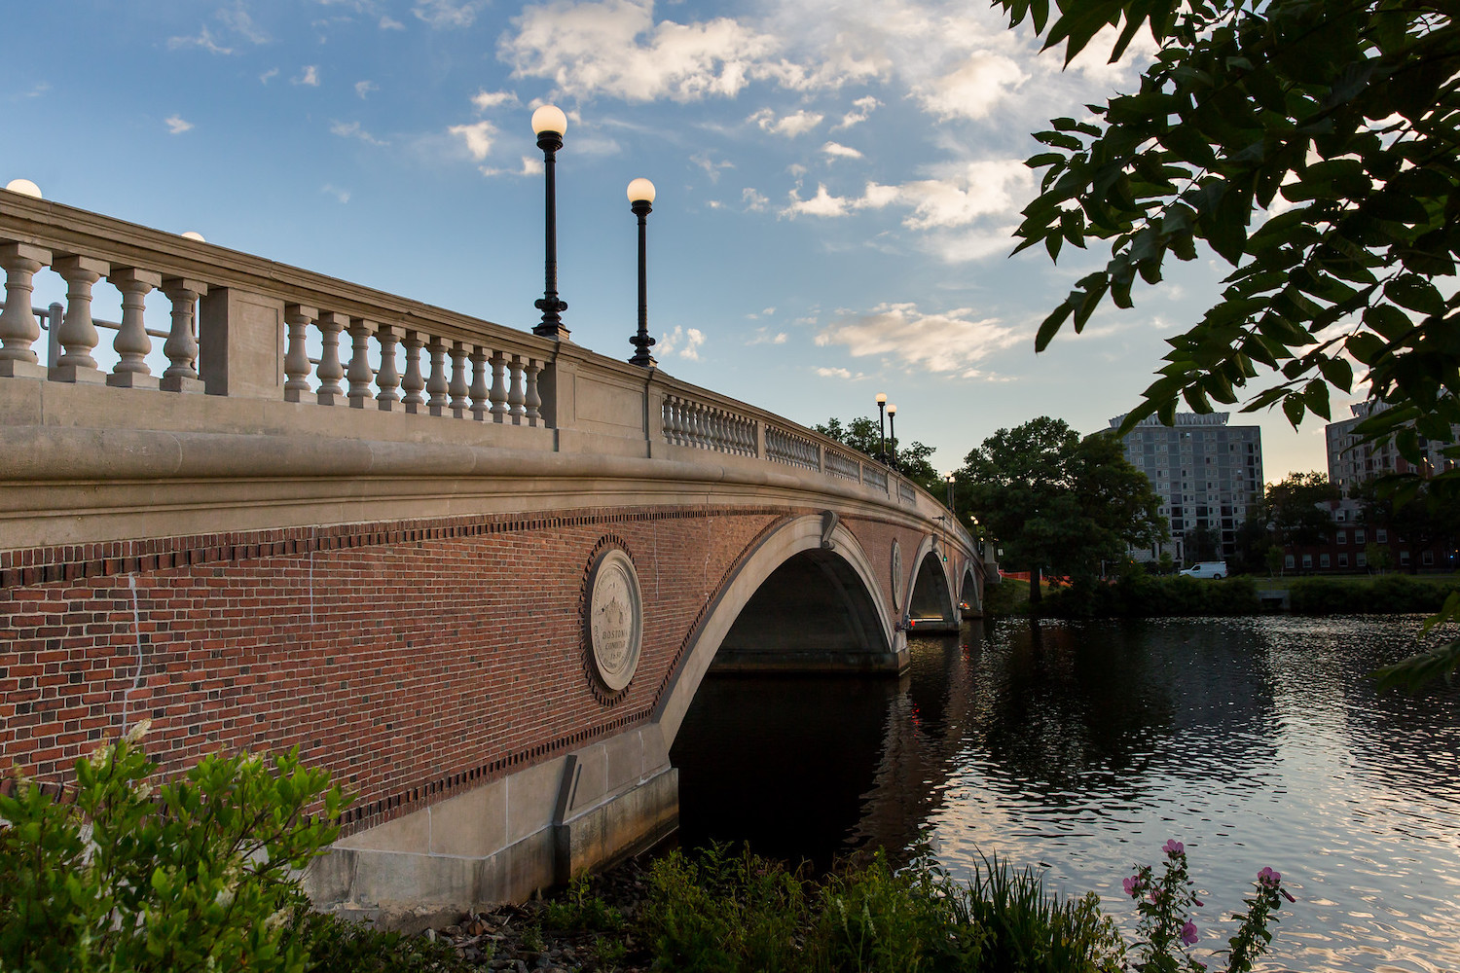

Slide 237
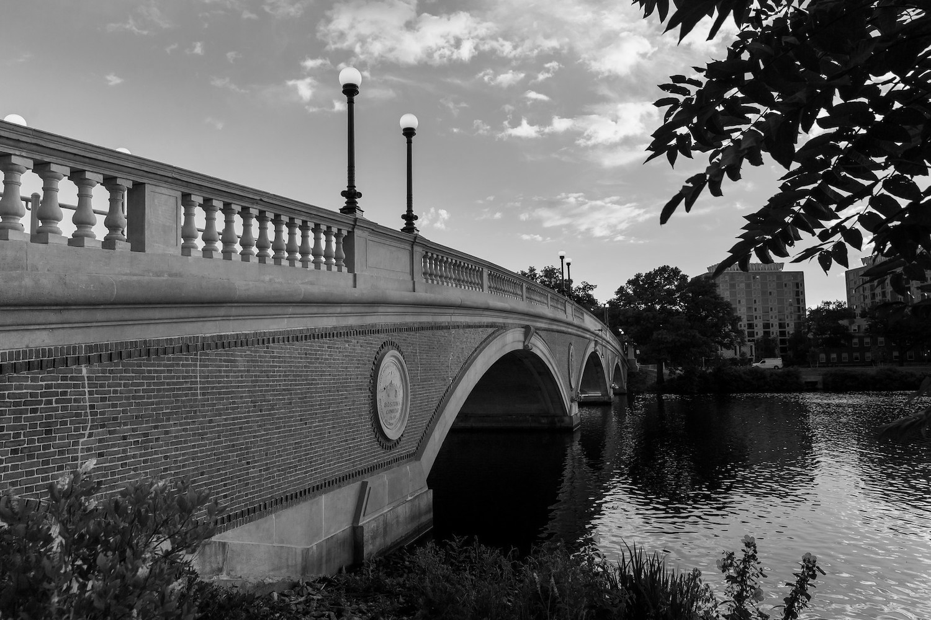
Notes:
grayscale

Slide 238
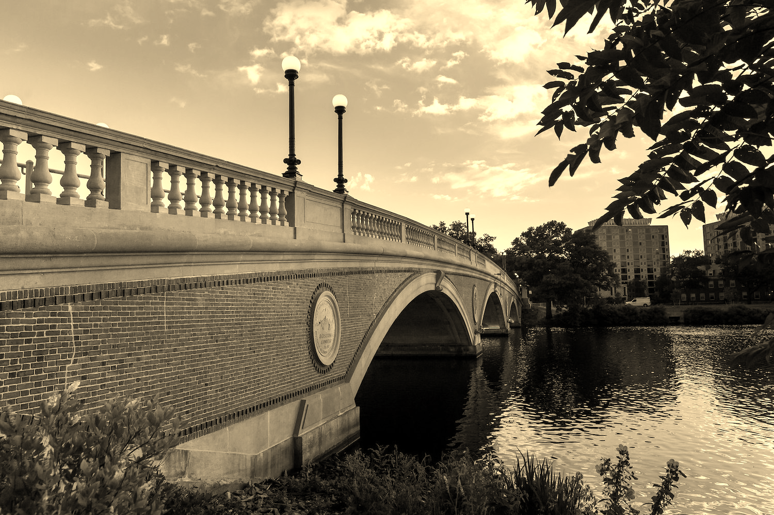
Notes:
sepia

Slide 239
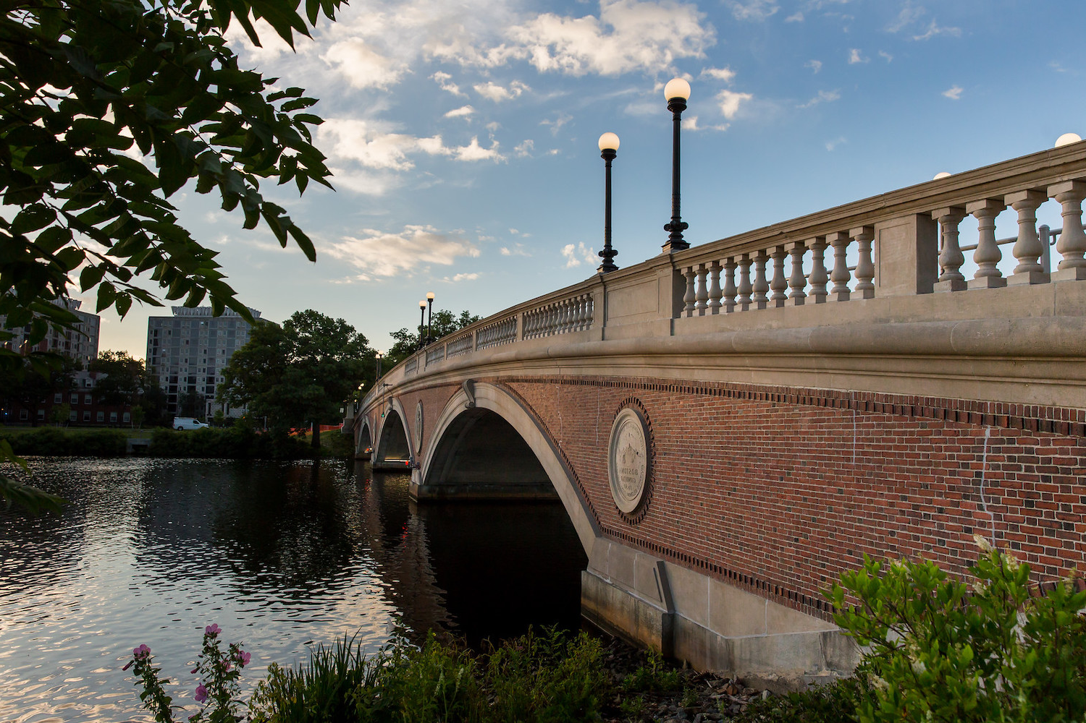
Notes:
reflect

Slide 240

Notes:
blur

Slide 241
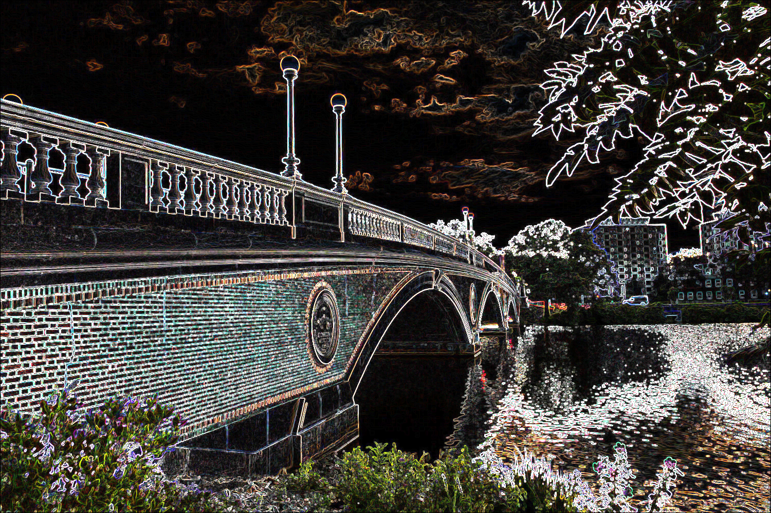
Notes:
edge detection

Slide 242
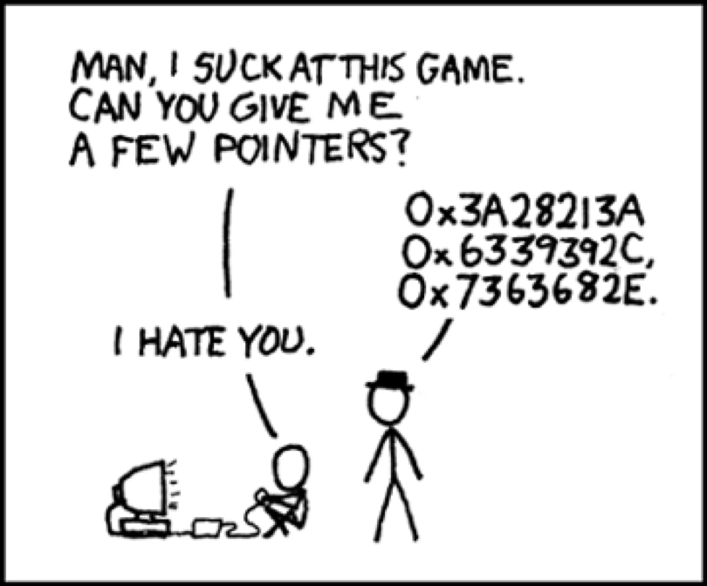
Notes:
https://xkcd.com/138/

Slide 243
Computing Technology

